Slide 1

Defense Legislation & Congressional Fellow Engagement on Capitol Hill
AACOG Virtual Briefing

Slide 2

Understanding How Defense Policy Moves Through Congress
Key Themes:
Military fellows embedded in Congress
Bipartisan national security policymaking
NDAA and Defense Appropriations
Navigating the legislative process
Building effective partnerships with Congress

Slide 3
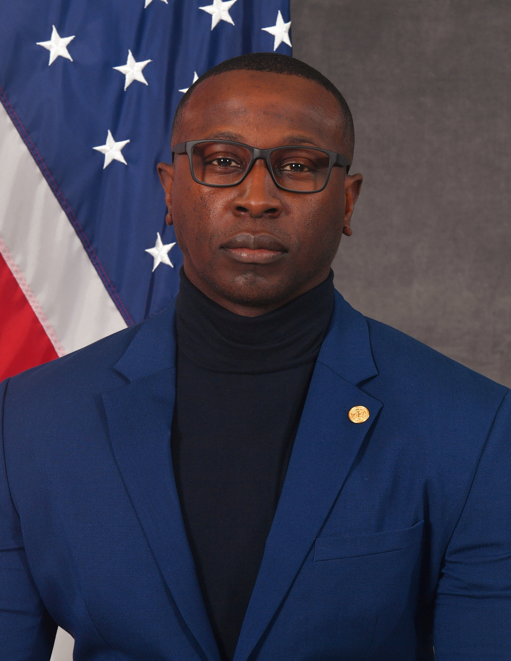
Meet the presenter
DESMOND BURGESS
Dr. Desmond M. Burgess is a U.S. Army Sergeant Major, Congressional Defense Fellow, educator, and published author with more than twenty years of leadership experience across military operations, professional military education, and national security policy. He supports defense policy development at the intersection of the Army and Congress and serves as a guest lecturer at the National Defense University, Reserve Component National Security Course.
He is the author of the leadership book If It Works… Keep Doing It and the Chronicles of the Eternal War fiction series. His work focuses on strategic leadership, decision-making, and the integration of operational experience into policy and leader development. Dr. Burgess holds a Doctor of Strategic Leadership and multiple graduate degrees in legislative affairs, information technology, and health science.

Slide 4

Why Regional Organizations Matter to National Security
Regional Governments and Organizations Influence
Military-community partnerships
Infrastructure resilience
Workforce development
Emergency preparedness
Defense industrial base support
Veteran transition programs
Installation-community compatibility
National Security is Increasingly Local
Defense policy directly affects regional economies
Installations depend on local partnerships
Workforce pipelines are now strategic assets
Communities help sustain military readiness

Slide 5
Embedded Military & National Security Professionals on Capitol Hill
Congressional Fellows Typically Come From
Active-duty military
Reserve components
National Guard
Civilian defense agencies
Federal national security organizations
Fellows Support
Legislative research
National security policy development
NDAA drafting
Oversight preparation
Hearings and member briefings
Stakeholder engagement
Interagency coordination
Unique Value Proposition
Operational experience
Strategic perspective
Technical expertise
Real-world understanding of defense systems

Slide 6
Bridging Policy and Operations
Congress Needs
Technical expertise
Operational context
Rapid policy analysis
Institutional continuity
Strategic insight
Fellows Help Answer Questions Like
How does this affect readiness?
Will this work operationally?
Does industry have capacity?
What are second-order effects?
How does this impact the warfighter?
Fellows are not Partisan Actors
Fellows support the constitutional process
Focus remains mission-oriented
National security often transcends party lines

Slide 7
Defense Policy Still Requires Coalition Building
Congress Needs
Technical expertise
Operational context
Rapid policy analysis
Institutional continuity
Strategic insight
Fellows Help Answer Questions Like
How does this affect readiness?
Will this work operationally?
Does industry have capacity?
What are second-order effects?
How does this impact the warfighter?
Fellows are not Partisan Actors
Fellows support the constitutional process
Focus remains mission-oriented
National security often transcends party lines

Slide 8

Defense Policy Still Requires Coalition Building
Despite Political Polarization
National security remains one of the most bipartisan areas in Congress
Major defense bills still require cross-party support
Defense issues often align around regional and strategic interests
Areas with Frequent Bipartisan Alignment
Military quality of life
Defense industrial base
Cybersecurity
Counter-UAS
Supply chain resilience
Veterans issues
Emerging technology
Effective Legislative Strategy
Build coalitions early
Align with committee priorities
Demonstrate district impact
Show national security relevance

Slide 9
The Annual Defense Policy Vehicle
The NDAA
Authorizes defense programs and policies
Sets priorities for the Department of Defense
Shapes military structure and authorities
Directs modernization efforts
Establishes oversight requirements
The NDAA is NOT
A funding bill
A direct spending mechanism
Major Focus Areas
Readiness
Procurement
Research & Development
Personnel policy
Emerging threats
Strategic competition
“Passed annually for over 60 consecutive years”

Slide 10
From Idea to Law
Step 1 - Stakeholder Engagement
Military services
Combatant commands
Industry
Think tanks
Local governments
Associations
Step 2 - Member Prioritization
District relevance
Committee priorities
National security value
Fiscal considerations
Step 3 - Committee Markup
House Armed Services Committee (HASC)
Senate Armed Services Committee (SASC)
Step 4 - Conference Process
House and Senate negotiate differences
Step 5 - Presidential Signature

Slide 11
Where Funding Actually Happens
Appropriations Provide
Budget authority
Program funding levels
Congressional spending direction
Oversight mechanisms
Key Accounts
Procurement
RDT&E
Operations & Maintenance
Military Personnel
MILCON
Appropriations Reality
Extremely competitive environment
Limited topline resources
High scrutiny on execution

Slide 12
Understanding the Difference
NDAA
Authorizes Programs
Sets policy
HASC / SASC
Straight direction
Annual authorization
Appropriations
Funds programs
Provides money
HAAC-D / SAC-D
Fiscal execution
Annual funding

Slide 13
How Ideas Become Legislative Action
Effective Engagement Requires
Clear problem definition
Strategic relevance
Fiscal realism
Coalition support
Data-driven justification
Timing awareness
Questions Congressional Staff Ask
Why now?
Why this office?
What committee has jurisdiction?
Is there Pentagon support?
Is industry aligned?
Is there bipartisan viability?
Timing is Everything
NDAA cycles
Appropriations windows
Hearing schedules
Markup deadlines

Slide 14
Where Congress is Focused Today
Priority Areas Include
Artificial Intelligence
Counter-UAS systems
Cybersecurity
Space capabilities
Supply chain resilience
Rare earth minerals
Advanced manufacturing
Autonomous systems
Quantum technologies
Energy resilience
Strategic Competition is Driving Legislation
China pacing challenge
Indo-Pacific posture
Domestic industrial capacity
Technology acceleration
“Trends”

Slide 15
Why Local and Regional Stakeholders Matter
Congress Increasingly Values
Regional innovation ecosystems
Public-private partnerships
Workforce pipelines
Academic collaboration
Advanced manufacturing capacity
Infrastructure resilience
Local Engagement Opportunities
Installation support
Defense workforce initiatives
Technology transition
Emergency preparedness
Cyber partnerships
“Communities that align with defense priorities gain advantage”

Slide 16
What Actually Works
Best Practices
Be concise
Be data-driven
Understand committee jurisdiction
Frame issues strategically
Align with national priorities
Build bipartisan relationships
Follow through consistently
Avoid
Overly technical messaging
Unclear asks
Last-minute engagement
Overpromising outcomes
Ignoring budget realities
“Credibility is currency on Capitol Hill”

Slide 17

Key takeaway
Typical Pathway
Operational problem identified
Stakeholders coordinate
Congressional office engaged
Technical validation conducted
Legislative language drafted
Committee staff engagement begins
NDAA or appropriations submission made
Coalition support expands
Markup negotiations occur
Program receives authorization/funding
Legislation is a process of persistence and coalition-building

Slide 18
Final Thought – National Security is a Team Sport
More Takeaways
Defense fellows help bridge operations and policy
Bipartisan collaboration remains essential
NDAA and appropriations are complementary
Relationships and timing matter
Regional organizations play a growing role in national security
Effective engagement requires strategy and persistence
Congress Increasingly Values
Innovation
Readiness
Resilience
Workforce development
Regional partnerships
“Communities that align with defense priorities gain advantage”

Slide 19

Questions
Thank you again for the opportunity to speak with AACOG today. I look forward to the discussion.

Slide 20

Thank you
Desmond Burgess​
desmond.burgess@mail.house.gov

